Slide 1

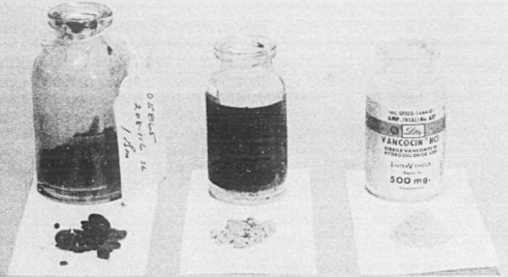

Simulation of vancomycin dosing regimen using a one-compartment model
Thomas Hill, DATA 604

Slide 2
Introduction
Vancomycin is a common adjuvant to empiric broad spectrum antibiotics
Gram positive coverage, including MRSA
Narrow therapeutic index
Antimicrobial activity - Minimum Inhibitory Concentration (MIC)
Toxicity: nephrotoxicity, ototoxicity, infusion reactions
Requires personalized dosing and intermittent monitoring
Dosed by weight, renal function
Trough levels before 4th dose
Loading dose?

Slide 3
Problem:
Are current dosing guidelines providing appropriate concentrations?

Slide 4
Approach
One-compartment model
Simulate patient, then generate dosing regimen
Compare initial and final trough concentrations
Loading versus non-loading
Sweep for most important parameters

Slide 5
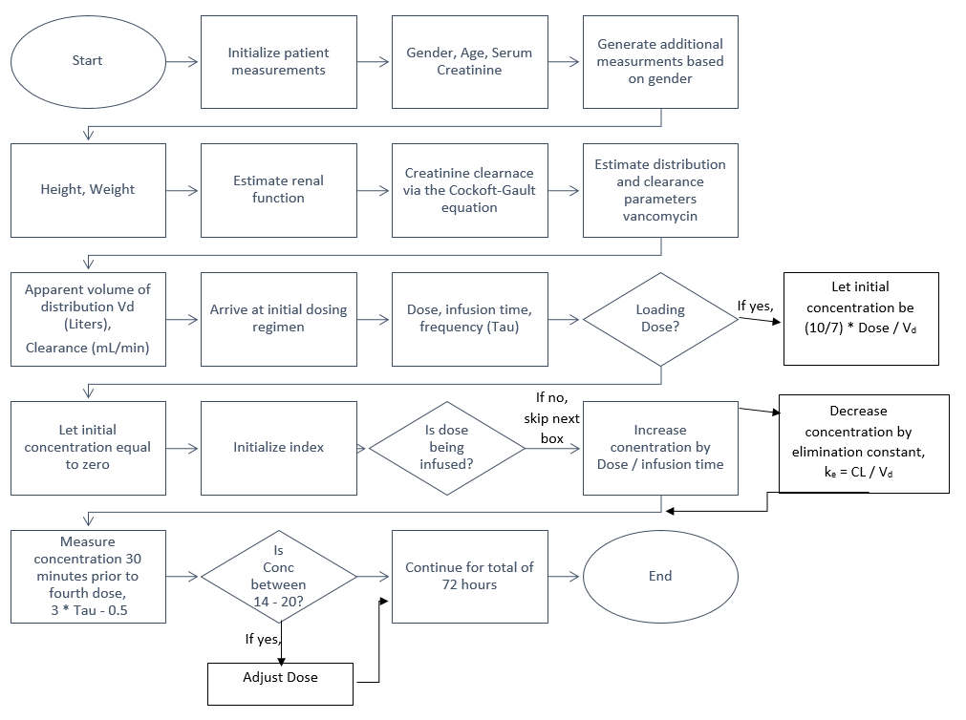
Flow Chart

Slide 6
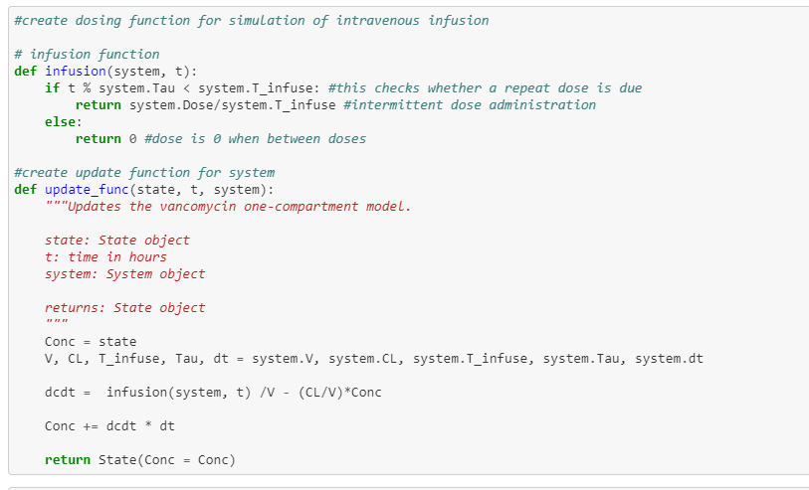
Model

Slide 7
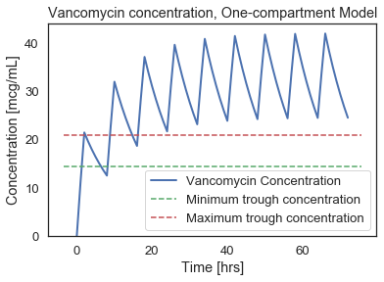
No loading dose

Slide 8
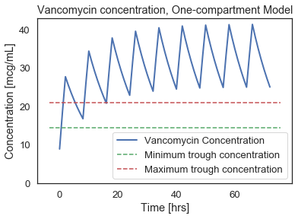
Loading dose

Slide 9
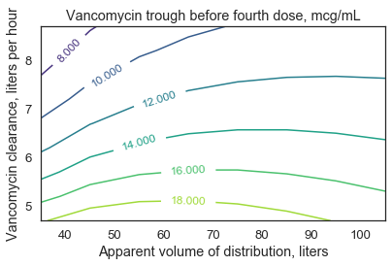
Sweep function

Slide 10
Conclusions, future directions
One-compartment model adequately simulates accumulation
Loading dose keeps levels high, but may require adjustment
Trough concentrations sensitive to changes in clearance
Future directions:
Two- or three- compartment model
Calculate area under curve (AUC) for antimicrobial activity
Simulate alternative dosing regimens (e.g., kidney disease)

Slide 11
Thank you
https://github.com/hillt5/DATA604/blob/master/DATA604_Final_Project_Thomas_Hill.ipynb

